Slide 1

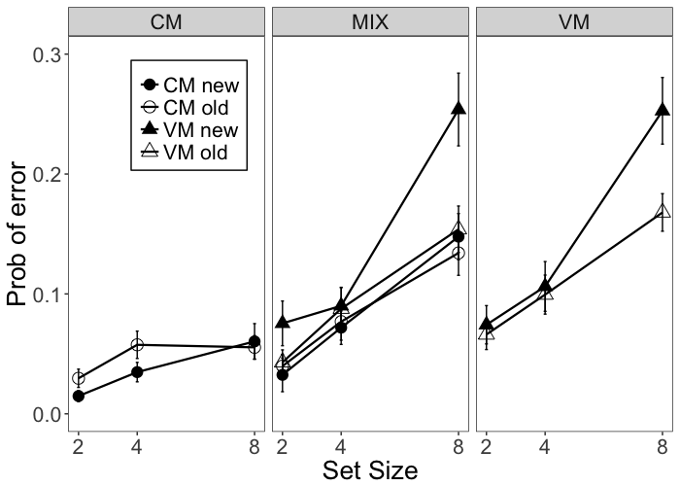
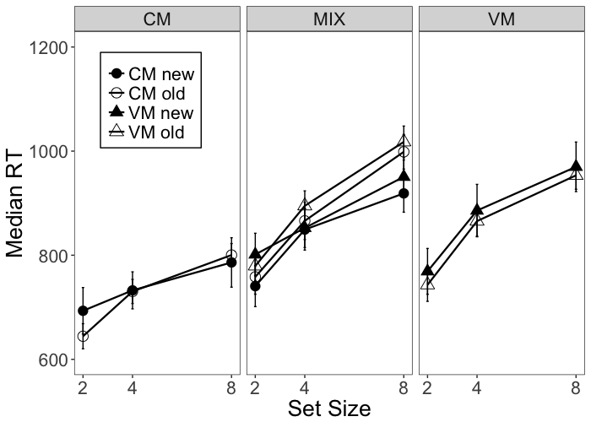
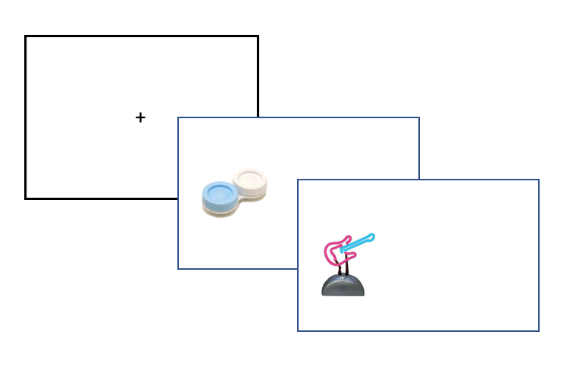
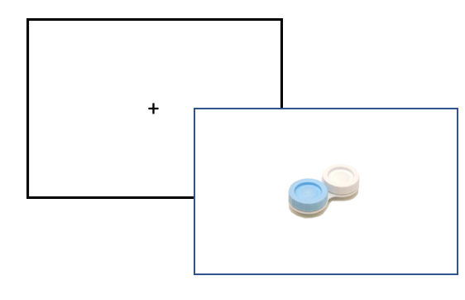
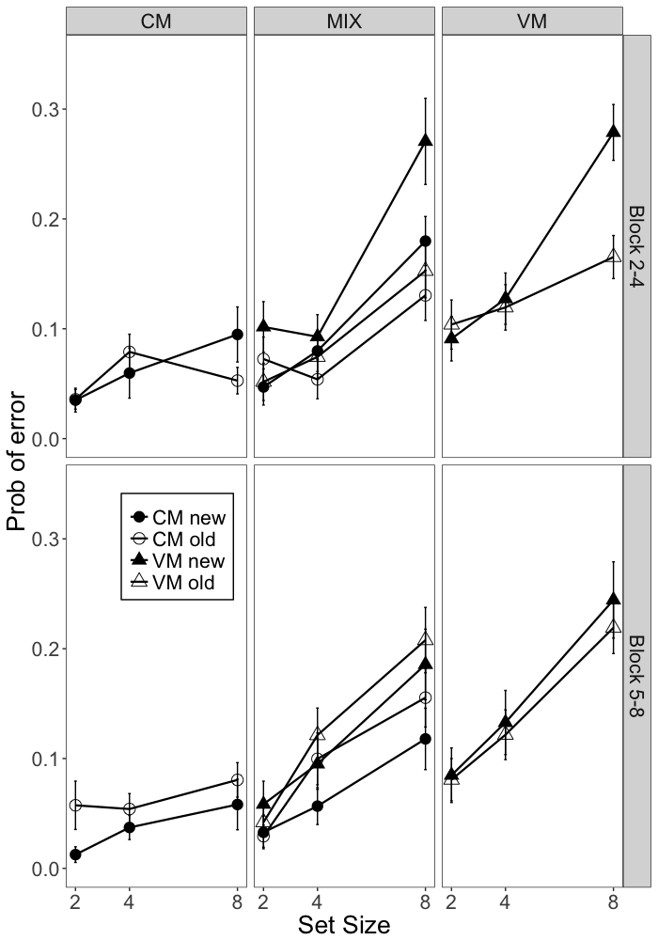
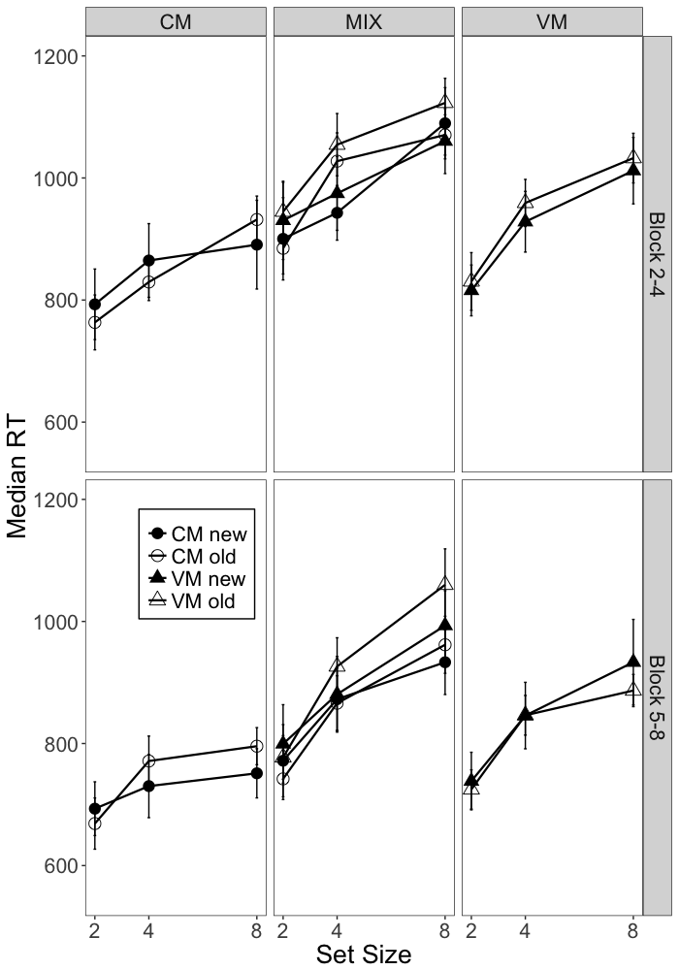
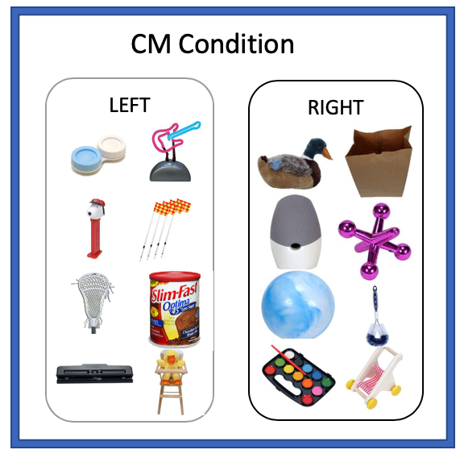
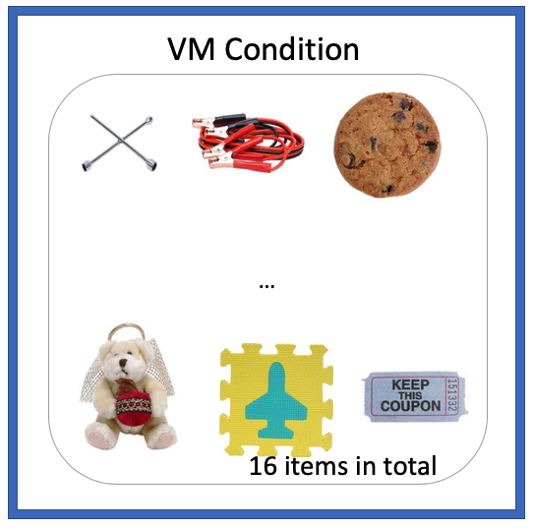
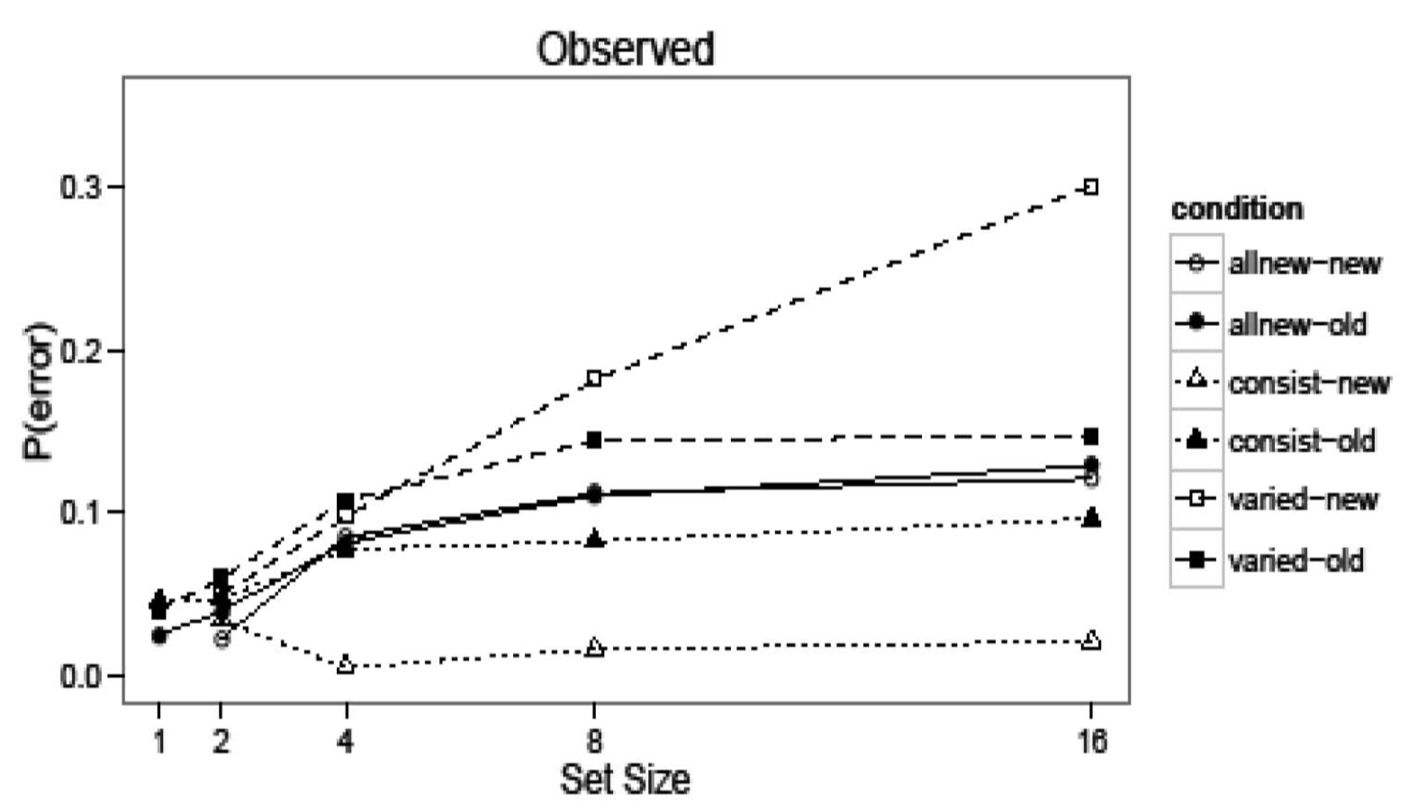
The Role of Long-Term Familiarity in Short Memory Search Recognition
Rui Cao; Ziqi Zhao; Robert Nosofsky; Richard Shiffrin
Indiana University Bloomington
Background
Research Question
Experiment Results
Automaticity refers to the highly efficient performance to some well learned task. e.g. foreign language, driving, reading. Those process can be cognitively demanding at first, but once acquired, it can be carried out easily and not limited by our working memory capacity.
Automaticity process is studied through memory search paradigm. Automatic performance can be achieved through CM training ( Nosofsky, Cox, Cao, Shiffrin, 2014; Schneider & Shiffrin 1977; Shiffrin & Schneider & 1977))
Memory search paradigm:
Item1, item2, item3… Probe (target -> old or foil -> new)
All new condition:
Each trial has a new set of items.
Prominent set size effect
Consistent Mapping Condition:
Target items are chosen from one fixed set of items; and foil items are chosen from another fixed set of items.
Lower error rate and shorter response time. Invariant across different set sizes.
Varied Mapping Condition:
A given item is sometimes a target, and sometimes a foil.
Performance improves very little, and it is strongly affected by set-size.
Theories proposed:
Item response learning: Responses are learned in long-term memory, and gradually become available in CM. Learning took place vary rapidly, within one session of training
No such learning in VM, subjects have to rely on familiarity
Question raised:
In CM, targets are seen more often than foils, and probably become more familiar. Performance could therefore be due to either long term familiarity or I-R learning.
Can we show that learning produces the performance seen in CM when familiarity differences are limited?
Three questions to be answered:
Q1: Are there differences between CM and VM in pure conditions?
Q2: Are they the same level as previous studies?
Q3: What about mixed condition?
Methods and Materials
Between Subject experiment: 3 conditions; CM, VM, and MIX.
Set size: 2, 4, and 8
30 subjects are recruited for each condition
Items are only presented on one side in each trial (left or right). Subjects need to response with left and right on keyboard.
Study Phase
Test Phase
Graph 1: error rate across three conditions
Graph 2: mean response time across three conditions
old = same side of study ;
new = opposite side of study
Graph 3: early block vs. later block across three conditions
Predicted Results
Conclusions
If familiarity is responsible for differences in CM and VM in previous experiment:
Subjects can not taking advantage of familiarity differences between foil and target in CM.
Accuracy and response time should be the same for the CM and VM conditions in our experiment.
If I-R learning is responsible for the differences in CM and VM in previous experiment:
We should replicate the pattern in previous studies.
Rapid CM learning with no set size effect
Pure CM has smaller set size effects than VM, so learning must be responsible.
There are set size effects in CM, so learning is incomplete and familiarity due to a focus upon the recent list is playing a role.
However, the CM and VM show similar set size effects when mixed. Therefore, mixing either suppresses or slows learning.
References
1. Schneider, W., & Shiffrin, R. M. (1977). Controlled and automatic human information processing: I. Detection, search, and attention. Psychological review, 84(1), 1.
2. Shiffrin, R. M., & Schneider, W. (1977). Controlled and automatic human information processing: II. Perceptual learning, automatic attending and a general theory. Psychological review, 84(2), 127.
3.Nosofsky, R. M., Cao, R., Cox, G. E., & Shiffrin, R. M. (2014). Familiarity and categorization processes in memory search. Cognitive psychology, 75, 97-129.
4. Cao, R., Shiffrin, R. M., & Nosofsky, R. M. (2017). Item frequency in probe-recognition memory search: Converging evidence for a role of item-response learning. Memory & cognition, 1-14.

